Slide 1

MOVING TO CHICAGO
EXPLORING FOOD, MUSIC AND POOL HALL VENUES

Slide 2
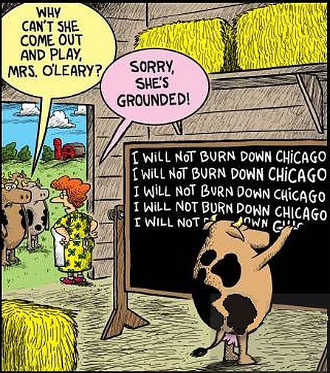
Consider the situation where I am having to relocate because of my job and I'm moving to Chicago.
Chicago will always be famous for “The Great Fire” of 1871, when a fire in the barn of Catherine and Patrick O'Leary spread across the city, killing hundreds
Now, Chicago is spiked with gorgeous architecture and set with cultural and recreational gems including the Art Institute, Millennium Park, 250 theater companies, and 30 miles of shoreline. Approximately 2.8 million residents live within the city limits.

Slide 3
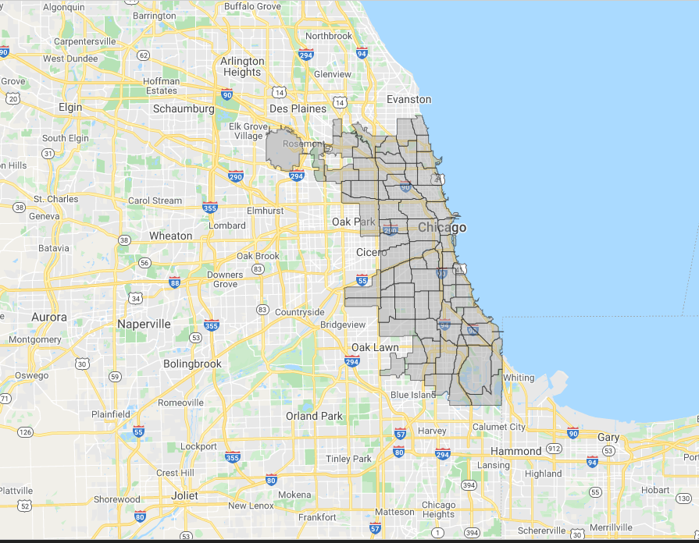
Chicago has 246 different community areas.
I would like to figure out where I would like to move and into what area neighborhood. I am going to base that choice on my main interests. What I would like is a nice selection of Restaurants, Music venues and Pool Halls.

Slide 4
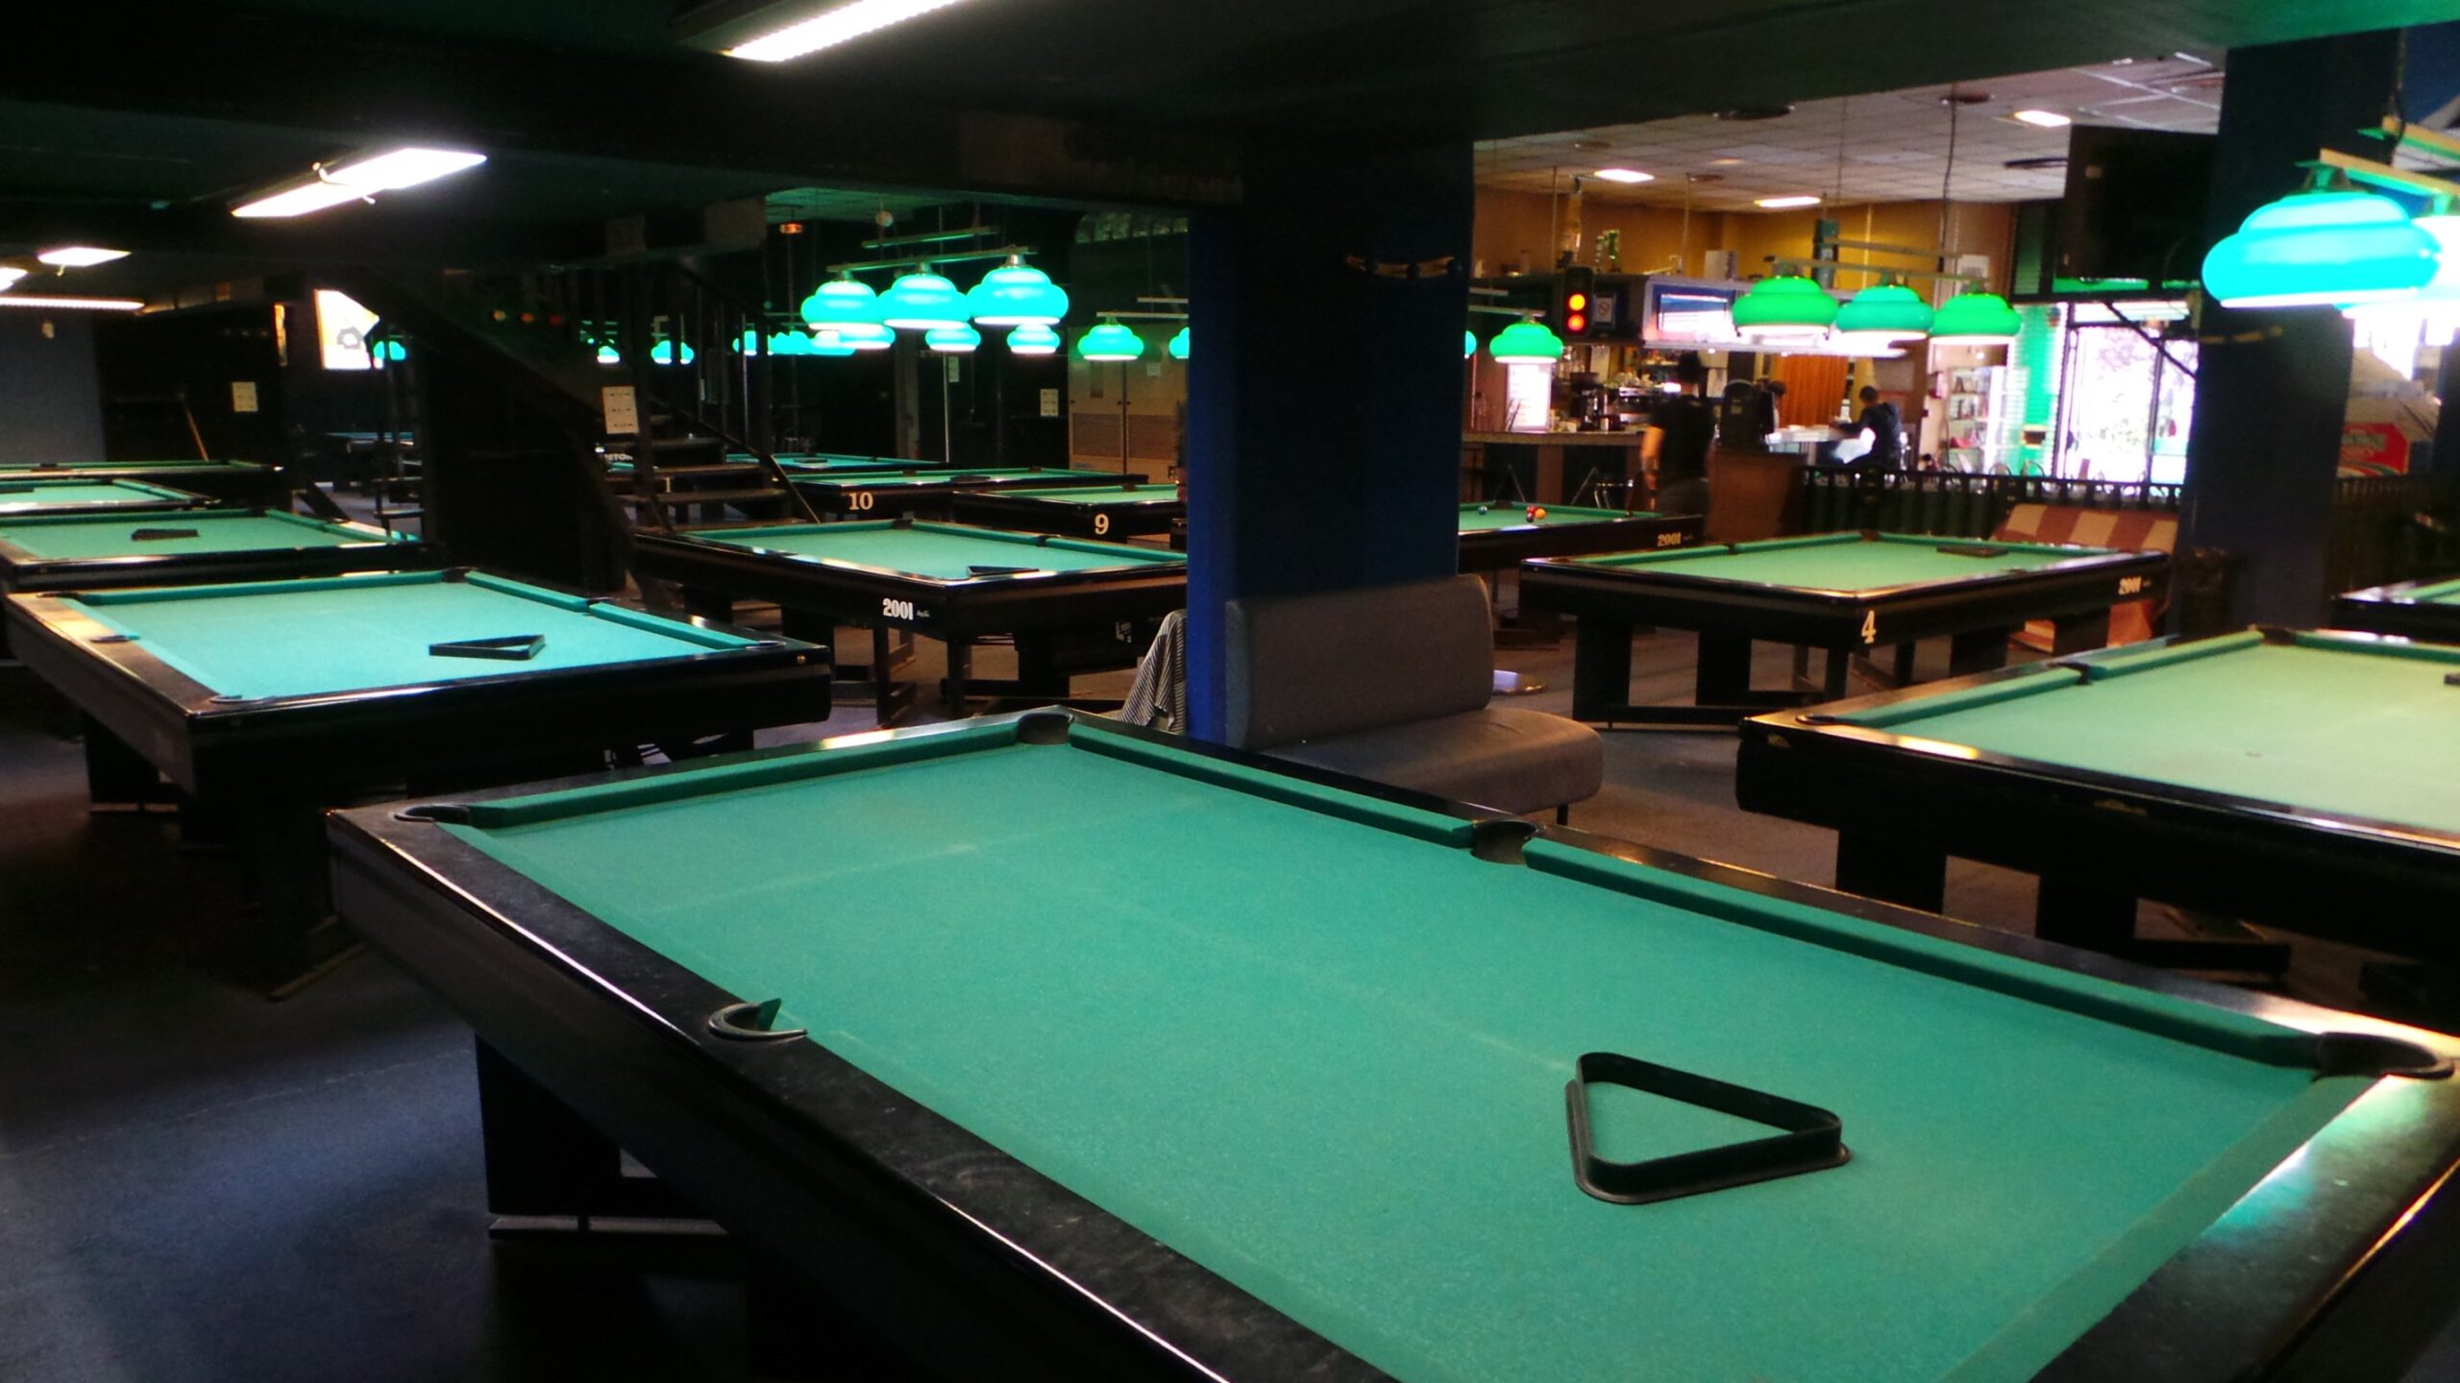

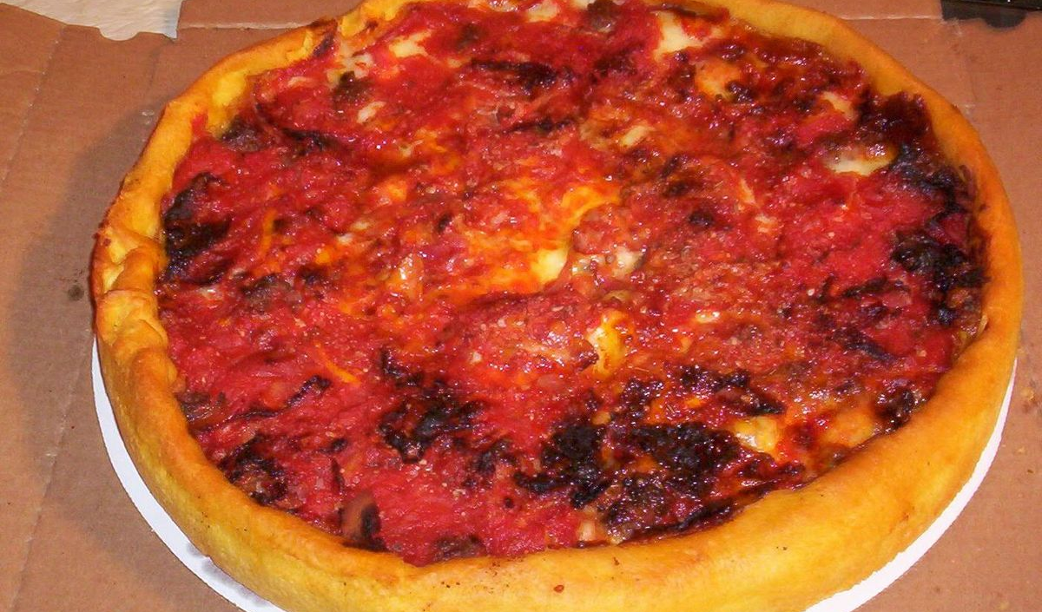

Slide 5
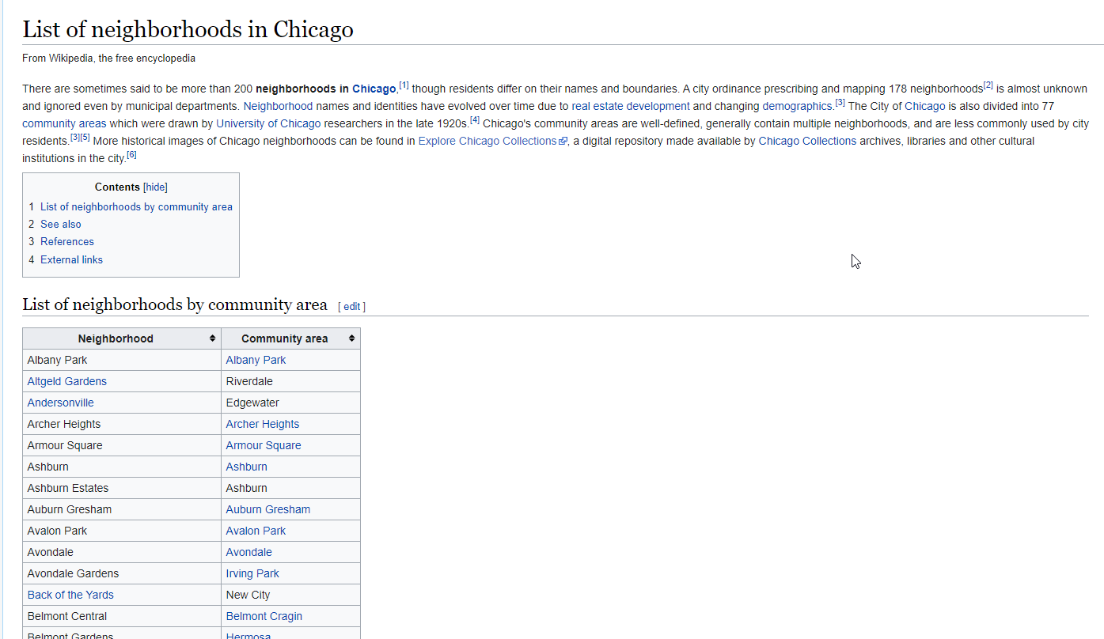
I’ve web-scraped the table for Chicago Neighborhoods and Community Areas and appended the latitude and longitude for each Community Area using the geopy library in Python. Venue data pertaining Restaurants, Music venues and Pool Halls was obtained via Foursquare
Table of Chicago Neighborhoods and Community Areas via Wikipedia

Slide 6
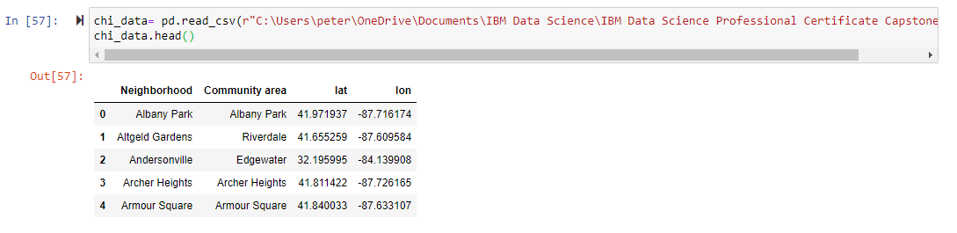
Using geolocator and geocode I looped through each row of the dataframe and found the corresponding latitude and longitude

Slide 7
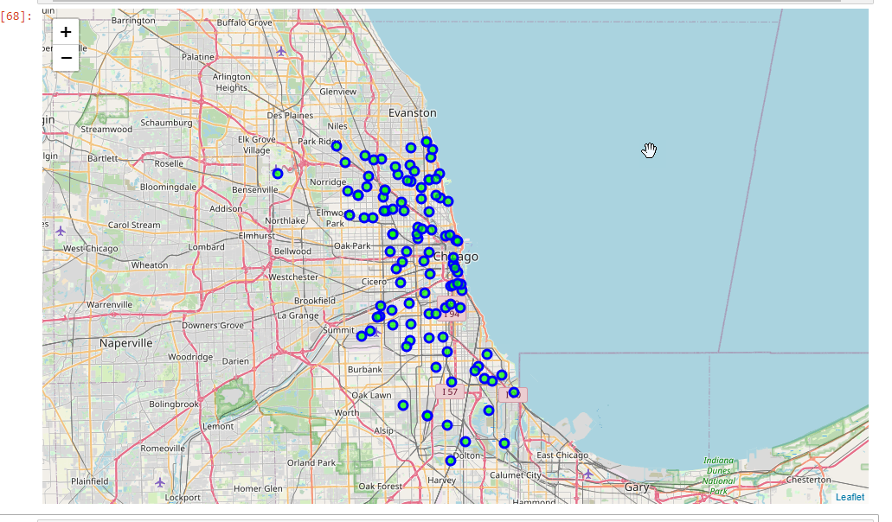
a map Of Chicago’s Neighborhood’s made with a folium map.

Slide 8
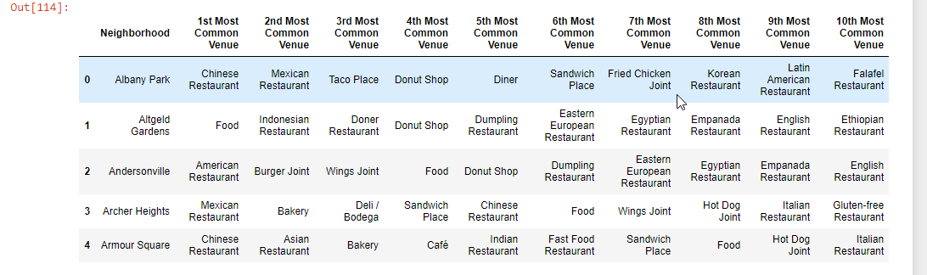
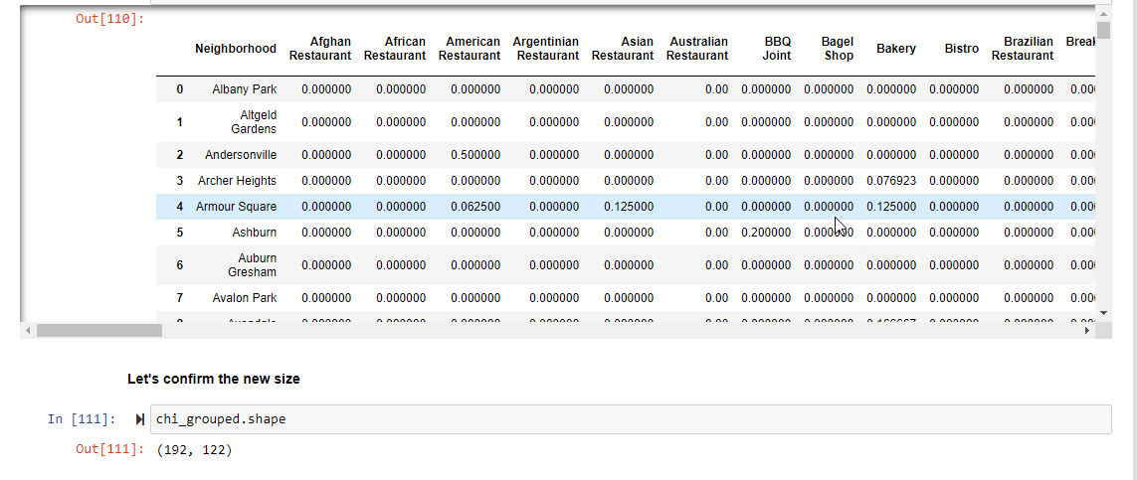
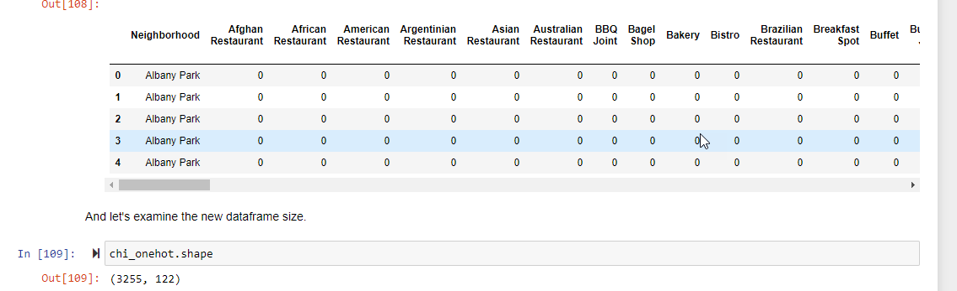
Using Foursquare we found venues that met our criteria (Restaurants, Music venues and Pool Halls).
Categorical Data is transformed into Numerical Data for Machine Learning algorithms.
Then we group rows by neighborhood and by taking the mean of the frequency of occurrence of each category.
And finally, we find the Top 10 Venues for each Neighborhood:

Slide 9
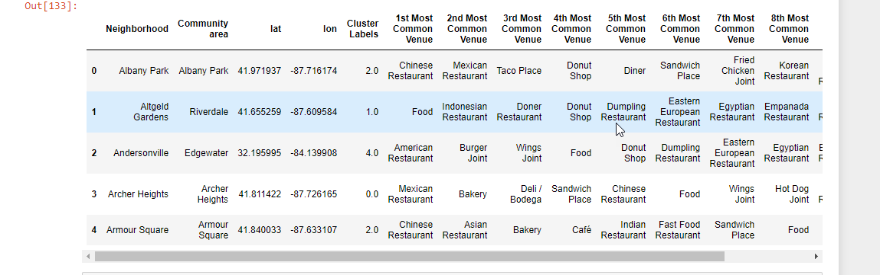
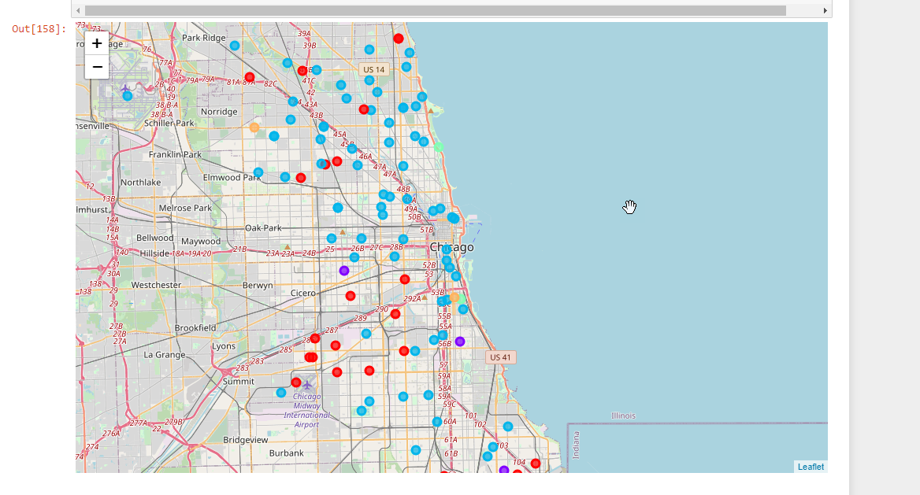
Learning with k-means Clustering We used k = 5 clusters and added the Cluster Label to our Dataframe:
Map of Clusters

Slide 10
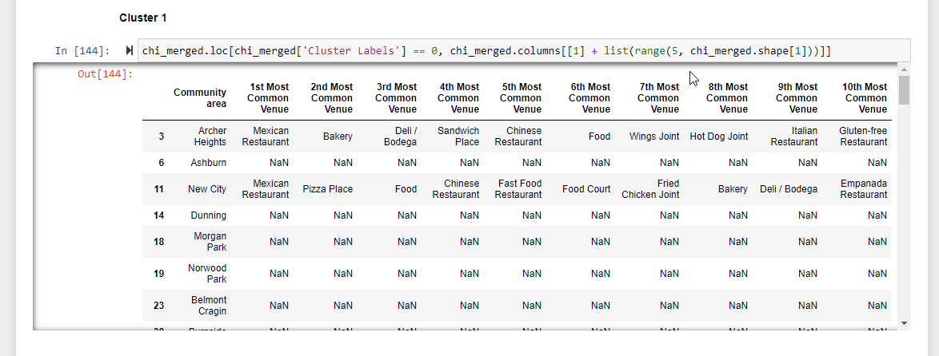
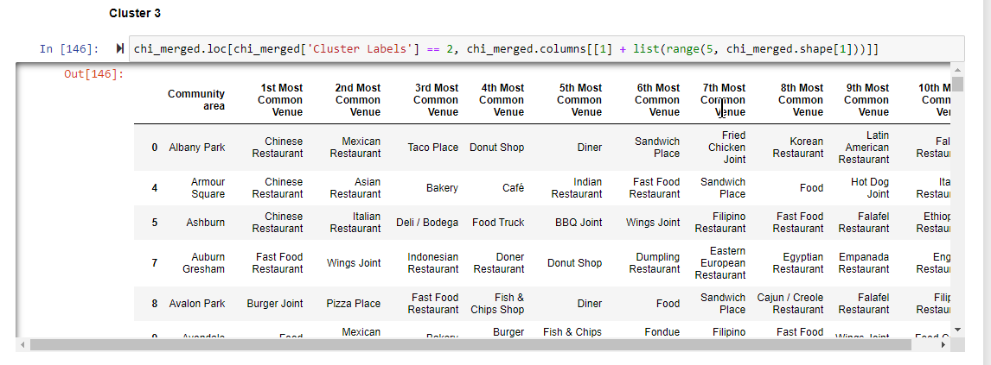
ClUSTER ANALYSIS clusters #1 and # 3

Slide 11

Discussion

Slide 12
Cluster #1 was the biggest, but most neighborhoods had no venues that I was interested in (NAN’s). Cluster # 3 was the second biggest and had a very nice variety of restaurant venues and food venues. Clusters # 2, # 4 and # 5 were all rather small and did not have much variety in feud venues. None of the clusters or at least very few of them had music venues or pool halls in the top 10.

Slide 13
Conclusions

Slide 14
Cluster # 3 is my choice for an area to start looking into the Real-estate market to find a place to live!! Though I am disappointed that there are not more Music venues and Pool Halls.

Slide 15
Further Investigations So, I did do a sub-search where I eliminated the Food venues and just checked Music venues and Pool Halls. Now there was some overlap because many of the Music venues and Pool halls also serve food and they showed up in the food category. But as evidenced in our clusters the Music venues and Pool Halls are so few and far between that I do not feel they would be a good criterion for a unique search. They would just limit the neighborhoods too much.

Slide 16
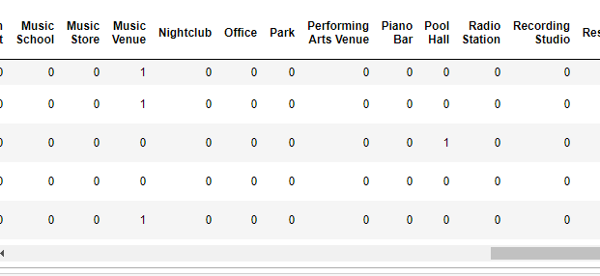
A snippet of results with Foursquare search for Just Music Venues and Pool Halls

